Slide 1

Project Analysis report
Title:- Seoul Bike Rental Demand Prediction
Subject:-Introduction to Statistical
Learning (DA546)
Submitted To:- Name:-Mohit Sharma
Dr. Rhythm Grover Roll No.:- 214161005
Department:- Data Science

Slide 2
# Research question:
How could we know how many bikes are rented per hour in function of weather conditions ?
# Obejctive of regression modeling :
Currently Rental bikes are introduced in many urban cities for the enhancement of mobility comfort. It is important to make the rental bike available and accessible to the public at the right time as it lessens the waiting time. Eventually, providing the city with a stable supply of rental bikes becomes a major concern. The crucial part is the prediction of bike count required at each hour for the stable supply of rental bikes.
# Data Description
The dataset contains weather information (Temperature, Humidity, Wind speed, Visibility, Dewpoint, Solar radiation, Snowfall, Rainfall), the number of bikes rented per hour and date information
Number of attributes :- 14
Number of instance :- 8760
Target attributes :- 1
Notes:
Mohit

Slide 3
#Exploratory data analysis And Data preprocessing
checking info of data
Data columns (total 14 columns):
# Column Non-Null Count Dtype
--- ------ -------------- -----
0 Date 8760 non-null object
1 Rented Bike Count 8760 non-null int64
2 Hour 8760 non-null int64
3 Temperature(°C) 8760 non-null float64
4 Humidity(%) 8760 non-null int64
5 Wind speed (m/s) 8760 non-null float64
6 Visibility (10m) 8760 non-null int64
7 Dew point temperature(°C) 8760 non-null float64
8 Solar Radiation (MJ/m2) 8760 non-null float64
9 Rainfall(mm) 8760 non-null float64
10 Snowfall (cm) 8760 non-null float64
11 Seasons 8760 non-null object
12 Holiday 8760 non-null object
13 Functioning Day 8760 non-null object
Checking missing values
Date 0
Rented Bike Count 0
Hour 0
Temperature(°C) 0
Humidity(%) 0
Wind speed (m/s) 0
Visibility (10m) 0
Dew point temperature(°C) 0
Solar Radiation (MJ/m2) 0
Rainfall(mm) 0
Snowfall (cm) 0
Seasons 0
Holiday 0
Functioning Day 0
checking correlation
From the heat map we see that temperature(°C) and Dew point temperature(°C) is highly correlated so we drop temperature(°C) or Dew point temperature(°C).
Check Multicollinearity by variance_inflation_factor
VIF score of an independent variable represents how well the variable is explained by other independent variables.
Notes:
Cont…

Slide 4
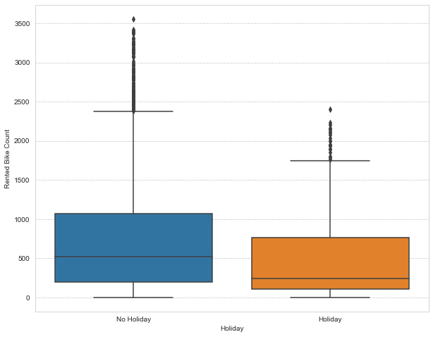
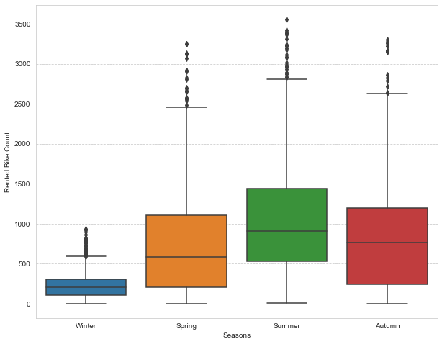
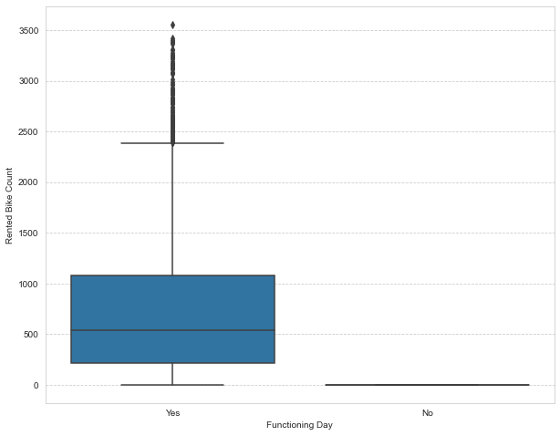
#plotting Box plot to visualize and trying to get information from plot
Less demand on winter seasons
Sligthly Higher demand during Non holidays
Almost no demnad on non functioning day

Slide 5
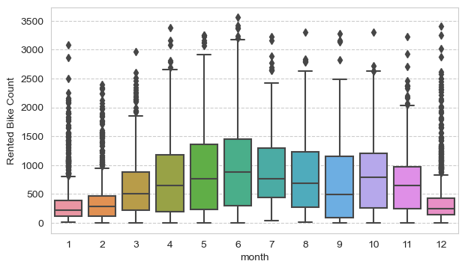
we can see that there less demand of Rented bike in the month of December, january,February i.e during winter seasons
Also demand of bike is maximum during May,june,july i.e Summer seasons

Slide 6
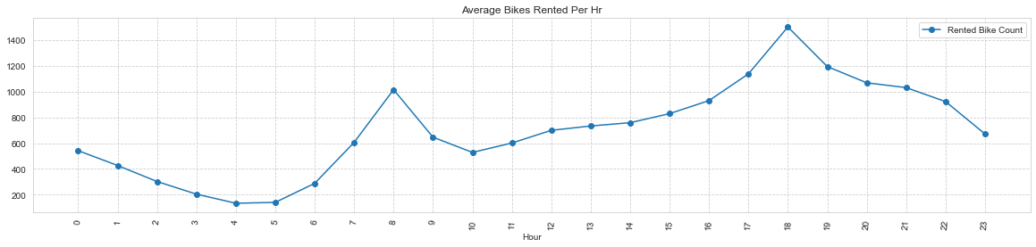
# ploting line graph doing group by Hrs and get average Bikes rented, and precent change
High rise of Rented Bikes from 8:00 a.m to 9:00 p.m means people prefer rented bike during rush hour.
we can clearly see that demand rises most at 8 a.m and 6:00 p.m so we can say that that during office opening and closing time there is much high demand

Slide 7
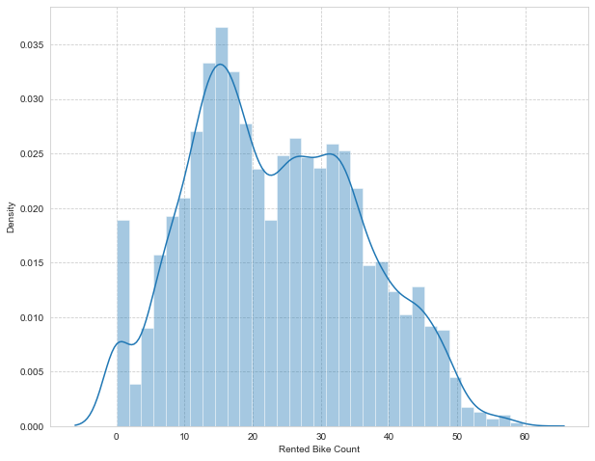
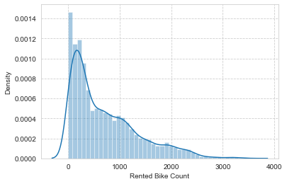
# Data preparation and Feature Engineering
# Numeric Features information
#Extracting categorical features
#creating Dummy variable for categorical columns
#concating numeric columns and dummy columns and creating final df
#visualising distribution of the target variable and doing square_root transformation for getting better result

Slide 8
# Modelling approach and selection of model
The basis of a multiple linear regression is to assess whether one continuous dependent variable can be predicted from a set of independent (or predictor) variables. Or in other words, how much variance in a continuous dependent variable is explained by a set of predictors. Certain regression selection approaches are helpful in testing predictors, thereby increasing the efficiency of analysis.

Slide 9
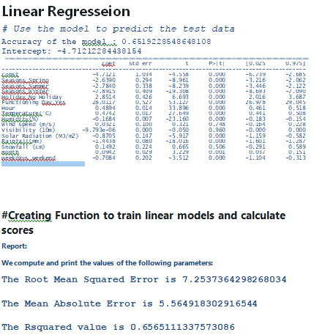
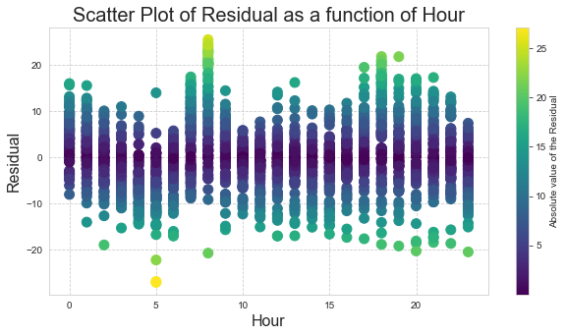
Model Result
We can clearly observe that our model fits the data with R2 value of 0.65.

Slide 10


